Slide 1

Heart Disease Prediction
By Mohammed Al-Shalchy, Paul Ahn, Walter Lampmann

Slide 2
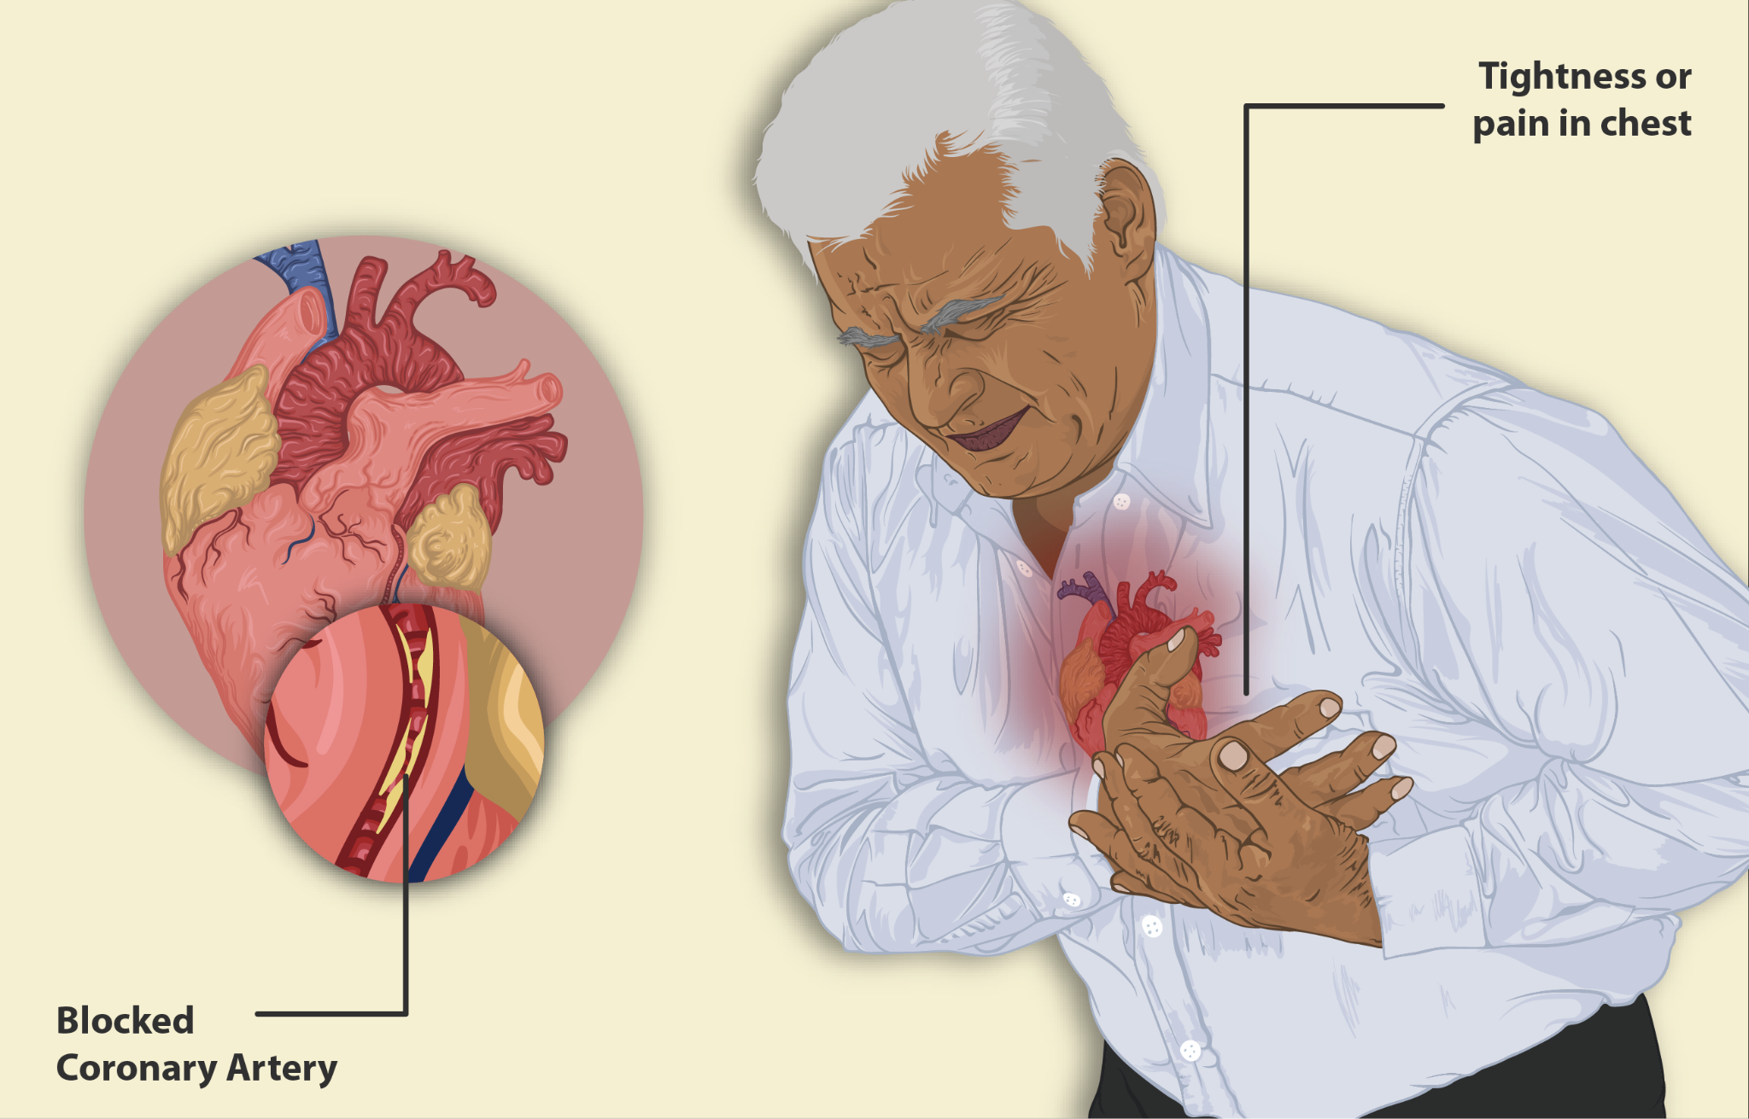
Motivation
According to the CDC, one person dies every 36 seconds in the United States from Cardiovascular diseases
About 659,000 Americans die from heart disease every year; that’s 1 in 4 deaths in the United States that are caused by heart disease
It used to be that we consider a human deceased when their brain ceases to function. With advancements in technology, we’ve reached a point where a human can be “brain dead” yet still alive.
Technology hasn’t advanced to keep someone alive if their heart stops functioning, so if the heart ceases to function, the human dies. This is why it is important to see who is likely to have heart disease and treat it before it’s too late.

Slide 3
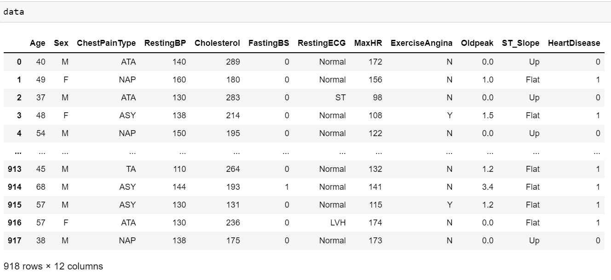
Dataset
This dataset was acquired from Kaggle, which combined heart disease data from the following locations/datasets: Cleveland, Hungary, Switzerland, Long Beach VA, and Stalog (Heart) Data set
Includes 12 Columns: Age, Sex, Chest Pain Type, Resting Blood Pressure, Cholesterol, Fasting Blood Sugar, Resting Electrocardiogram results, Maximum Heart Rate Achieved, Exercise Angina, Oldpeak, ST_Slope, and Heart Disease class

Slide 4

Data Cleaning
Initially, it looked like there needed to be zero data cleaning, since all rows were filled, but RestingBP and Cholesterol had a minimum of 0, which shouldn’t be possible.
Once looking at the distributions of RestingBP and Cholesterol, we found that only a couple of examples from RestingBP were 0 while an overwhelming majority of examples from Cholesterol were 0
We fixed this by replacing the zero values with the mean value of the RestingBP and dropping the Cholesterol value, since there was no meaningful analysis to be gained from keeping it around

Slide 5
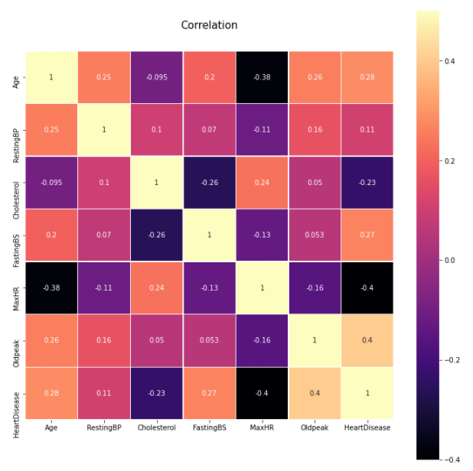
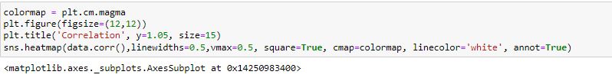
Data Cleaning Visualization 1

Slide 6
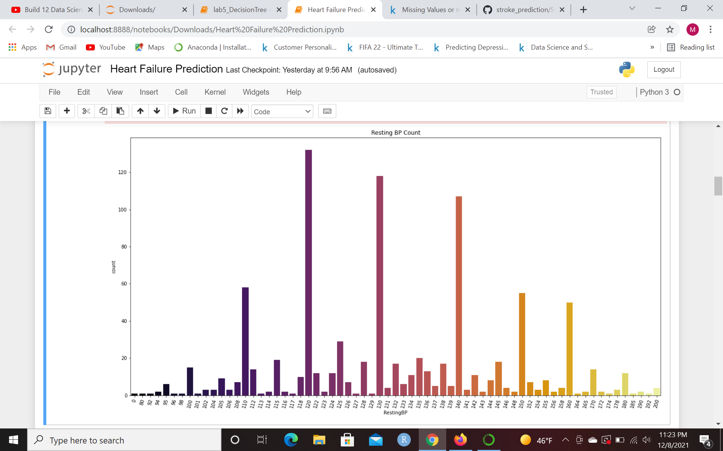
Data Cleaning Visualization 2

Slide 7
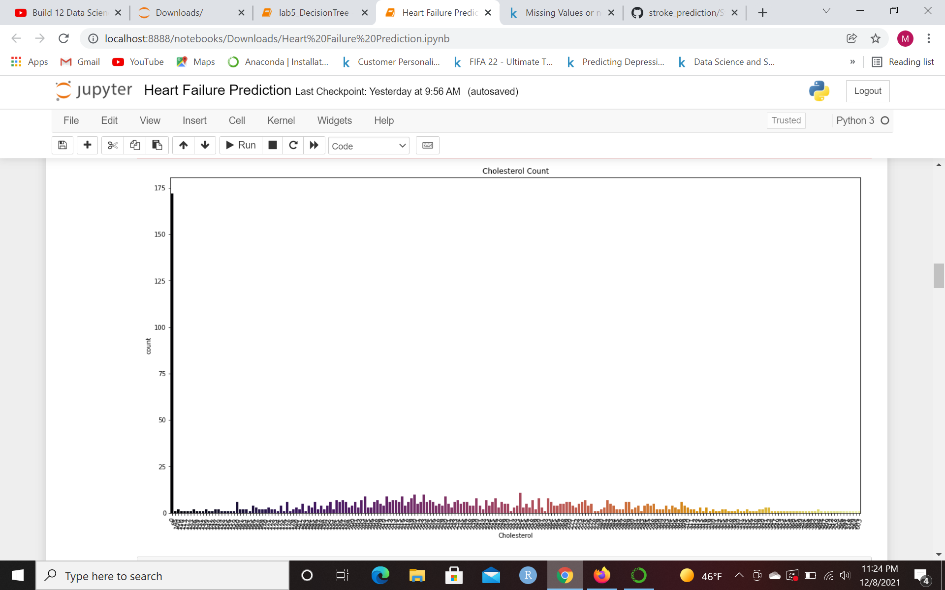
Data Cleaning Visualization 3

Slide 8
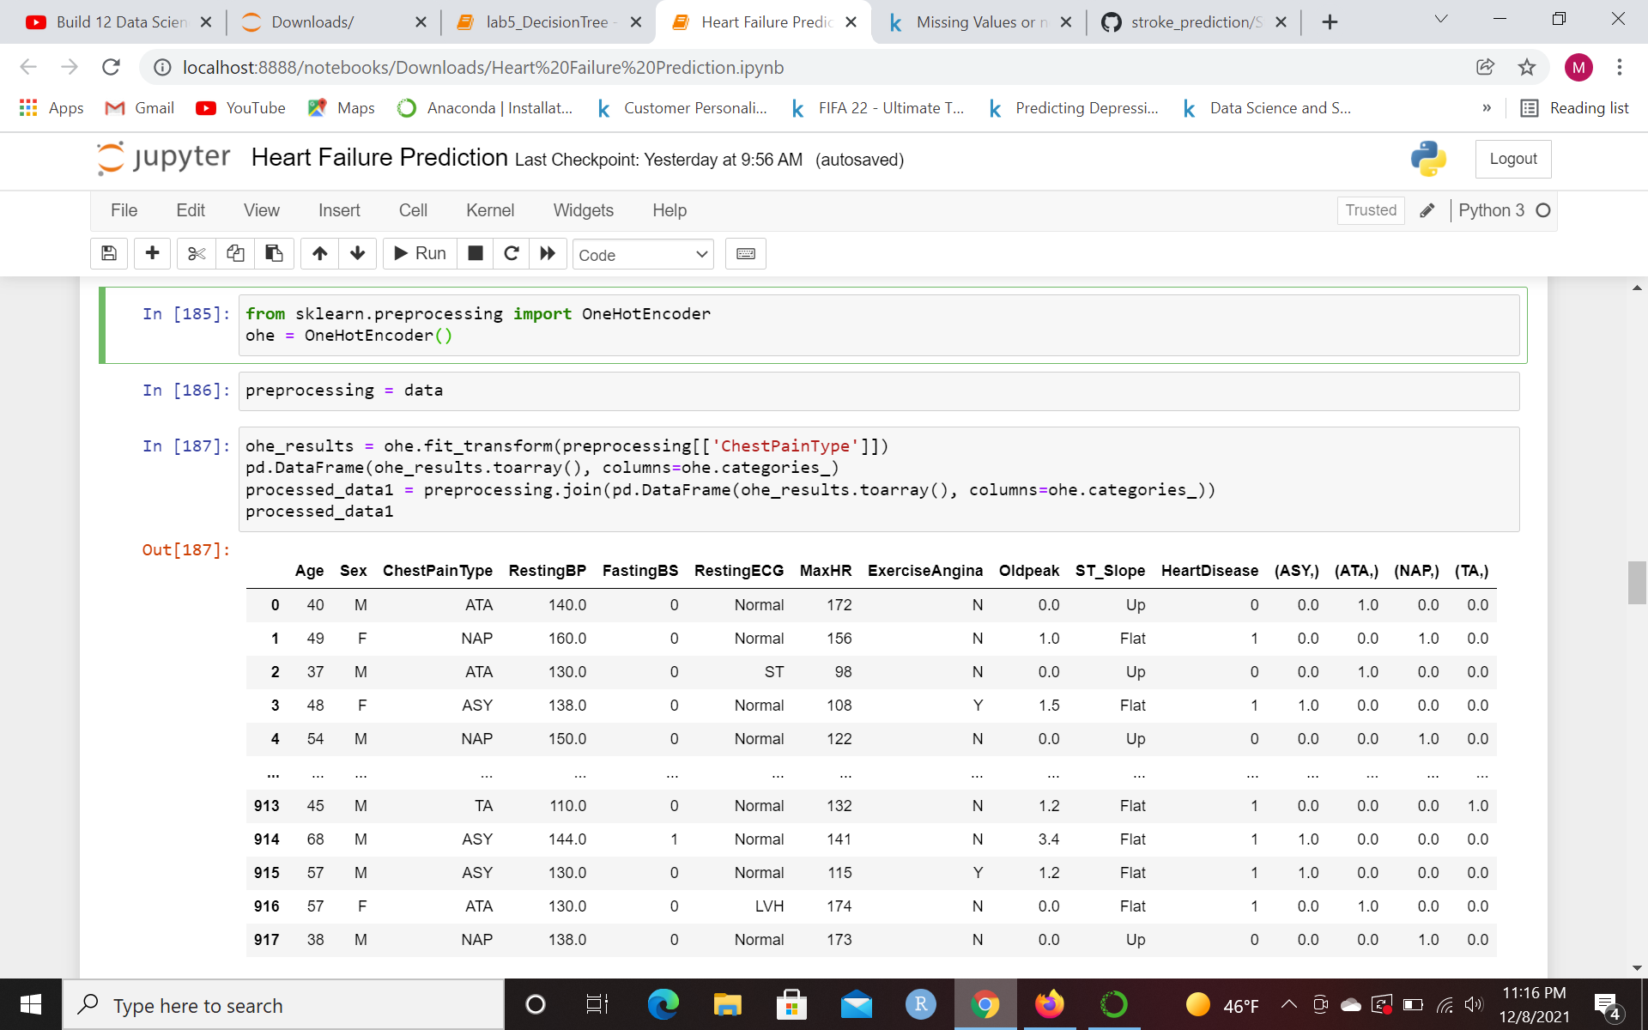
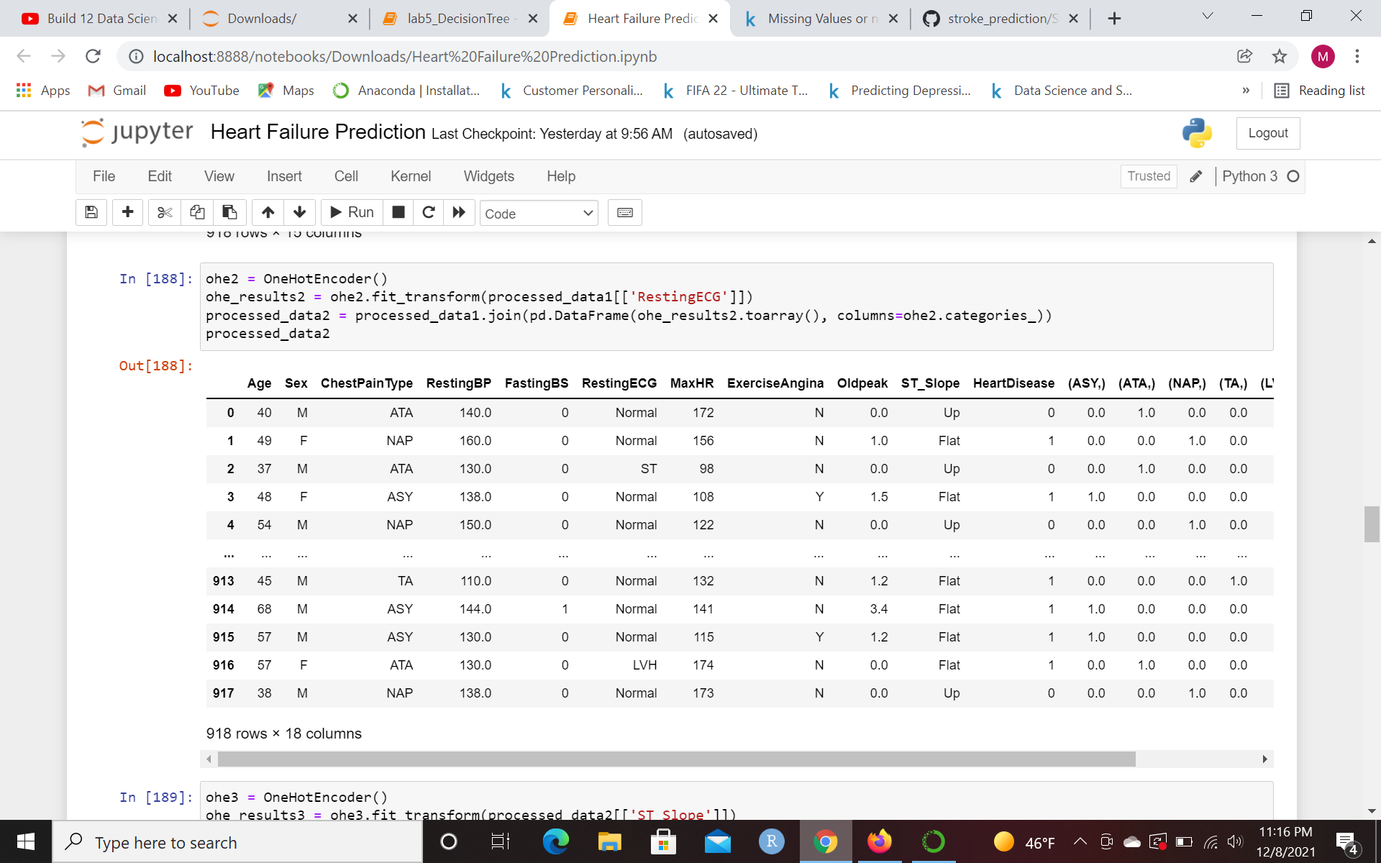
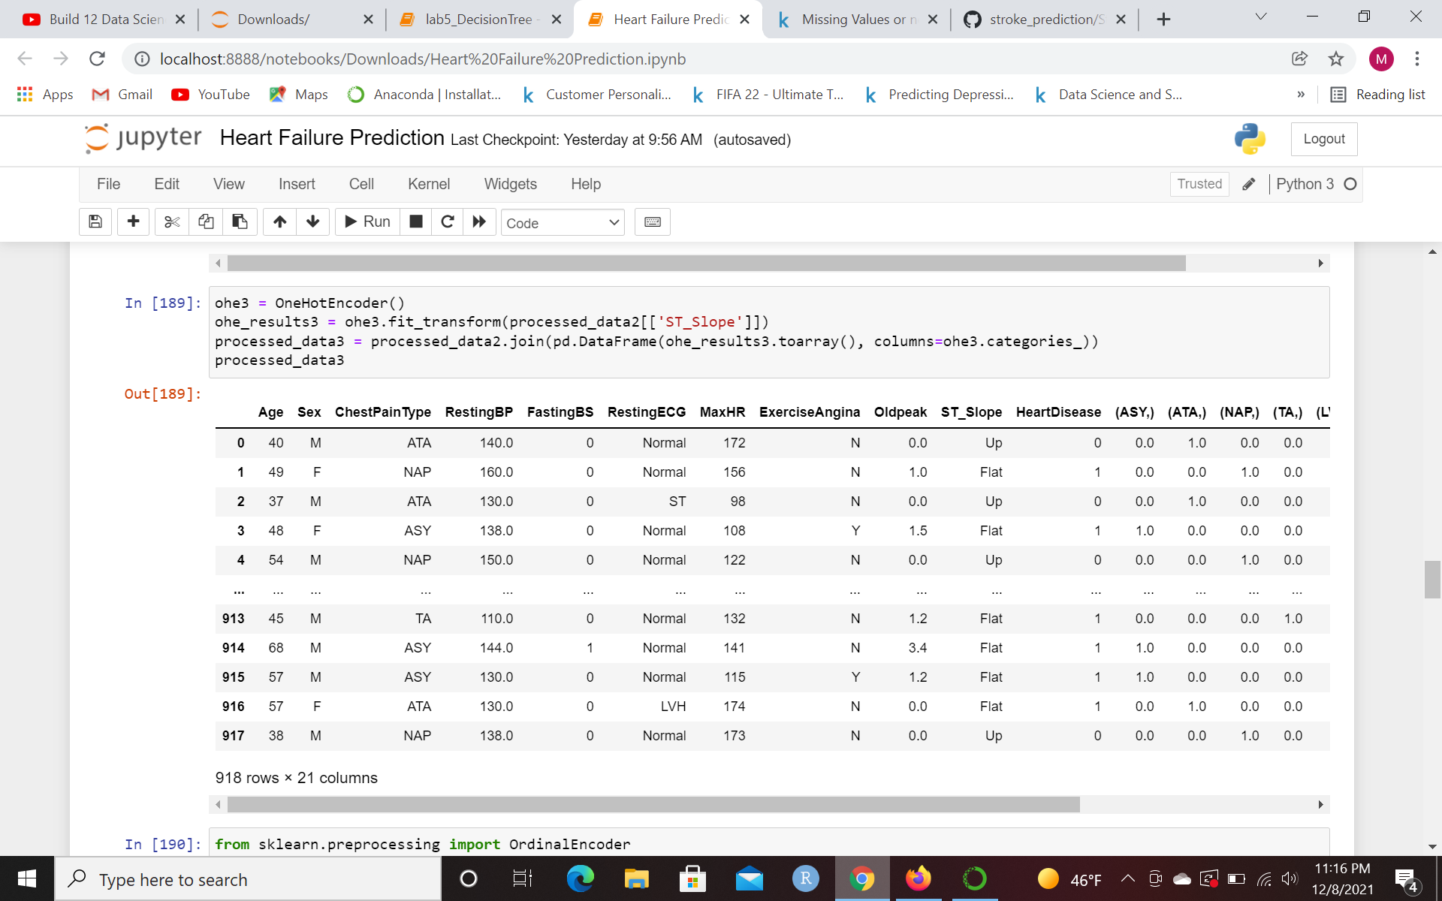
Preprocessing (1)

Slide 9
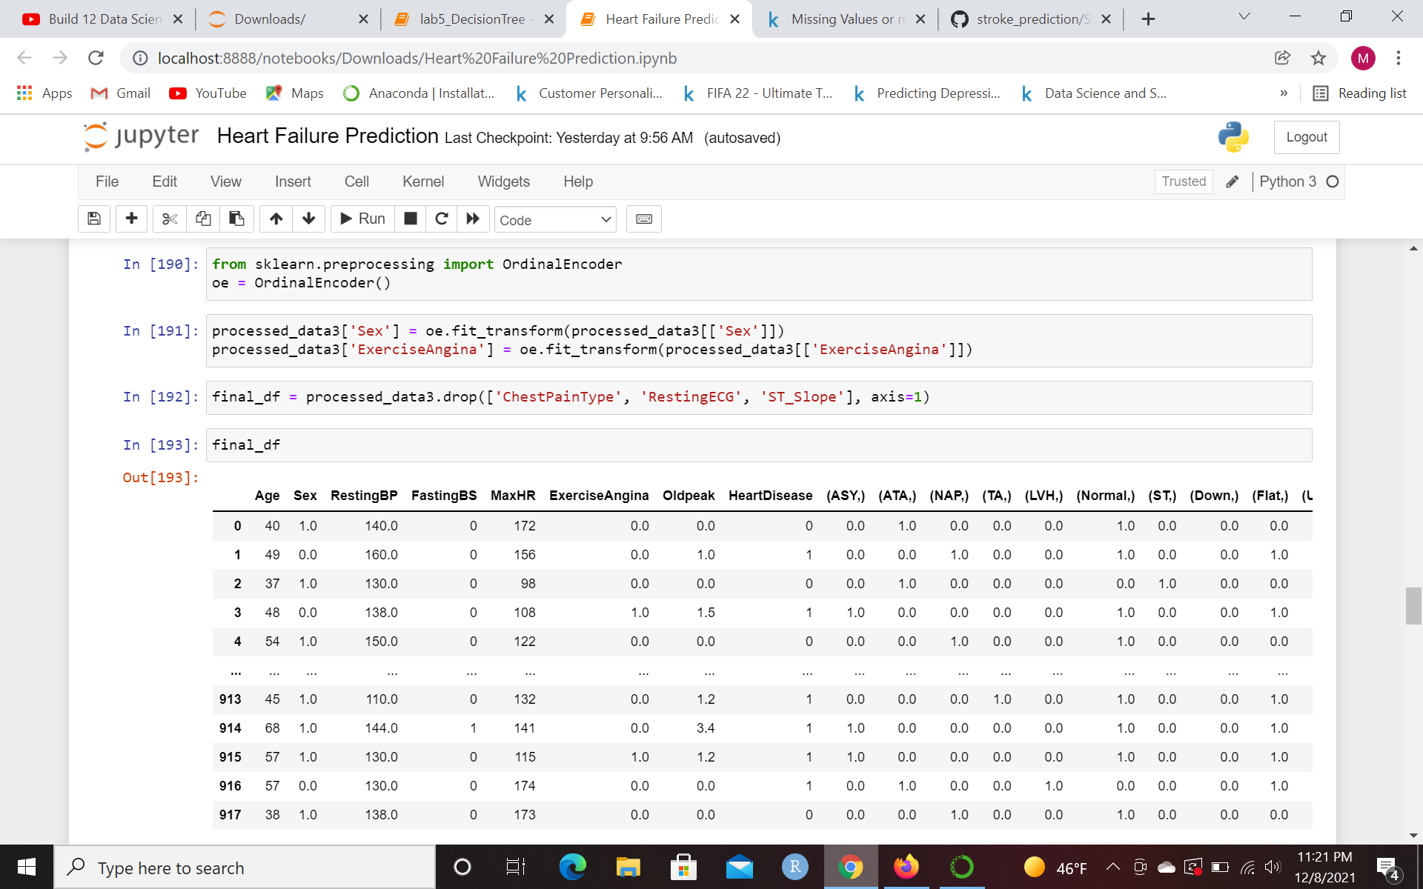
Preprocessing (2)

Slide 10
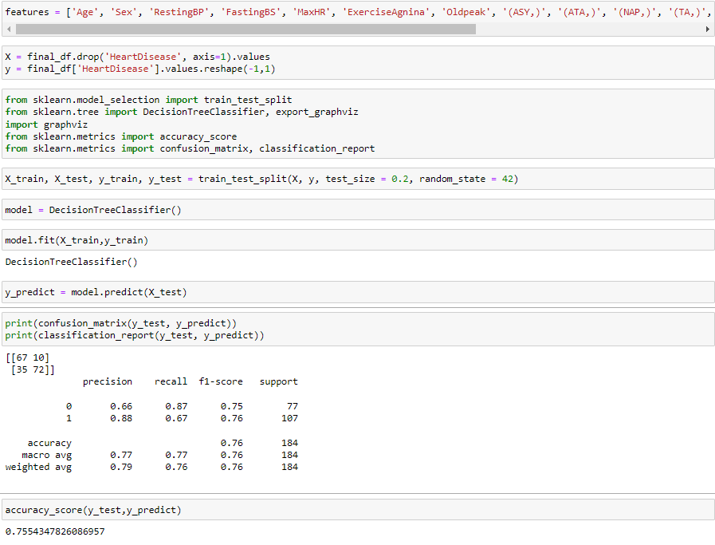
Model 1: Normal Decision Tree

Slide 11
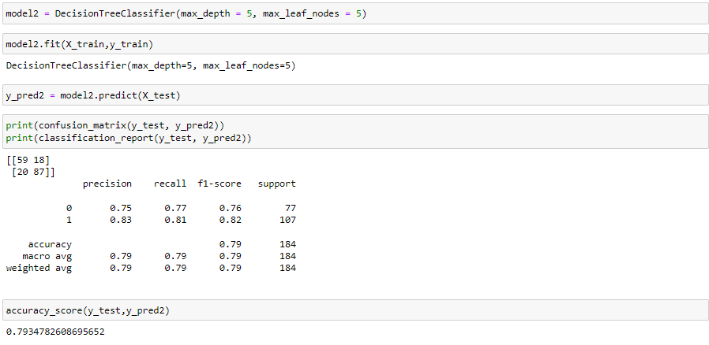
Model 2: Decision Tree with max_depth and max_leaf_nodes = 5

Slide 12
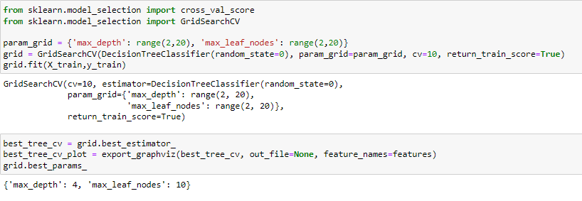
Model 3: Using gridsearch and cross validation

Slide 13
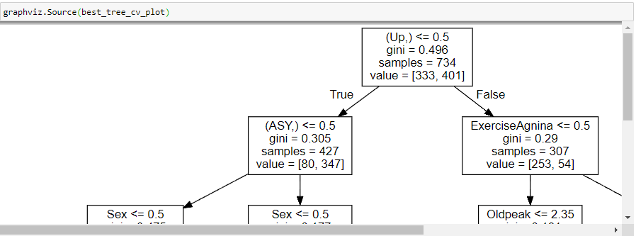

Slide 14
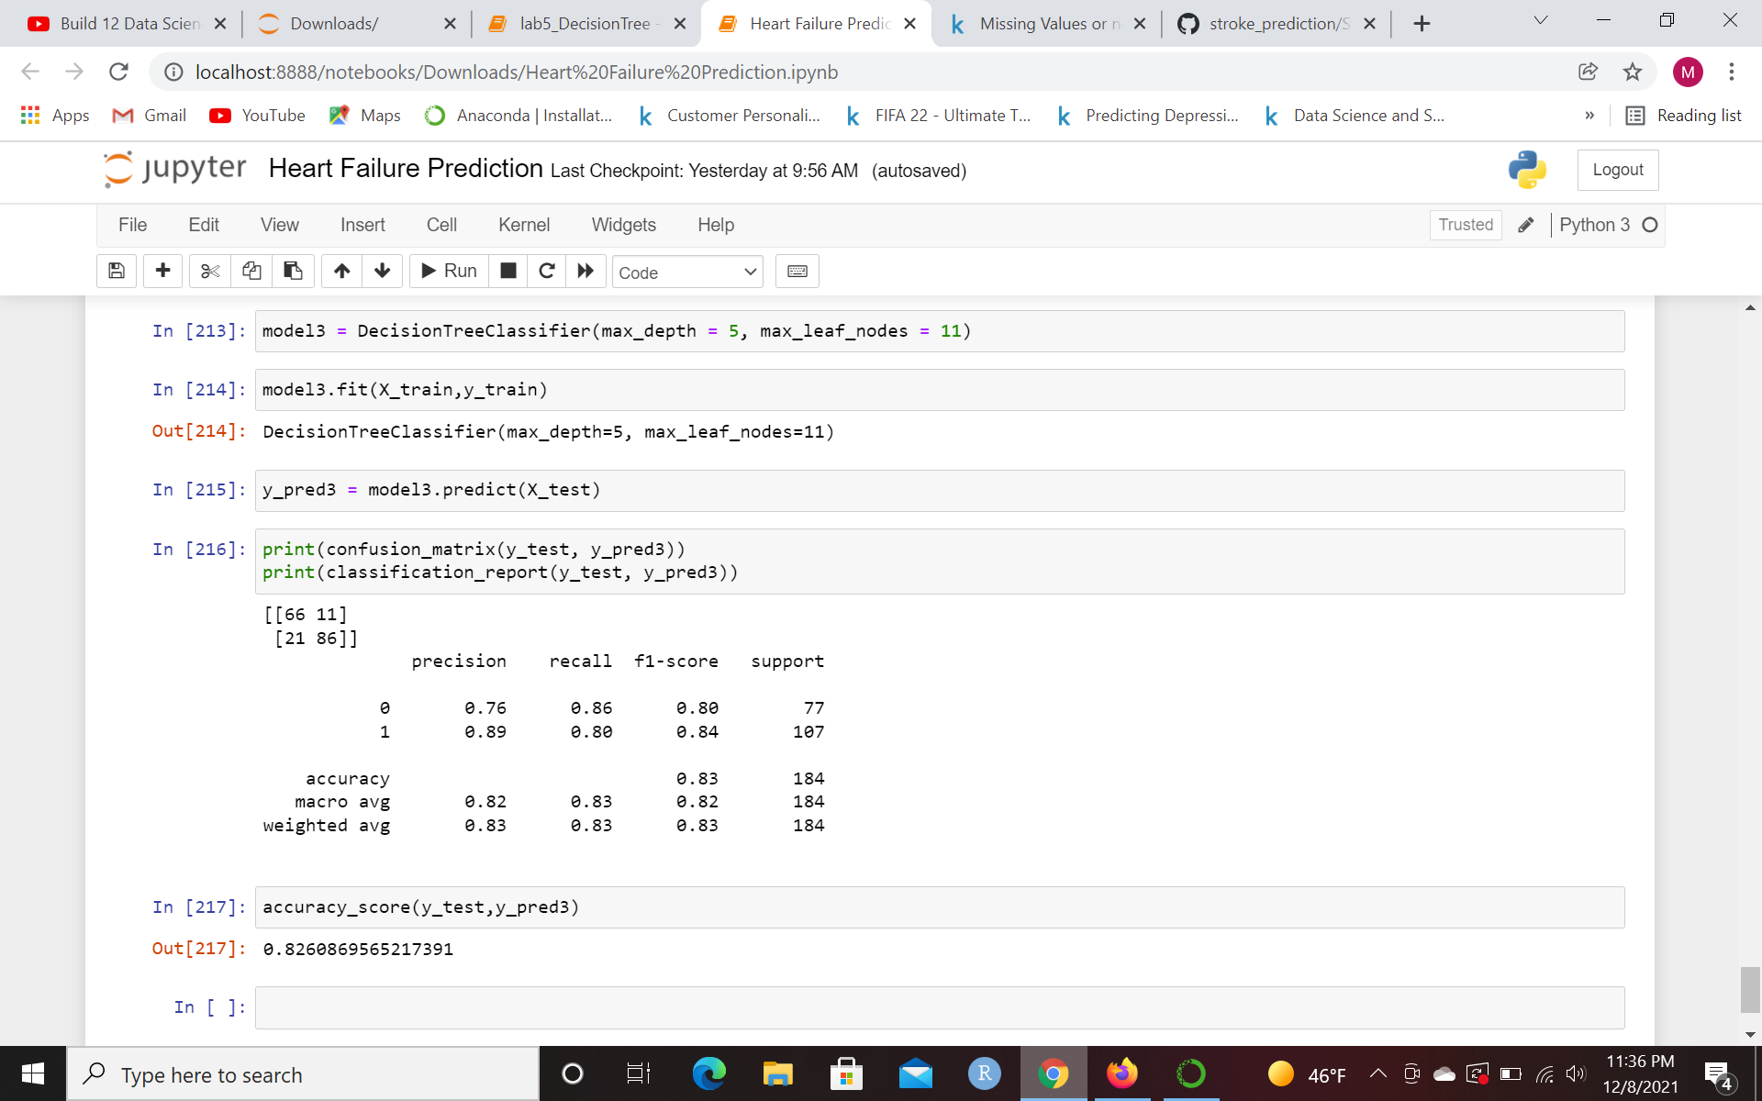
Model 3 Results

Slide 15
Live Demo

Slide 16
Conclusions
It is possible to create a model to predict someone’s likelihood of having heart disease using Decision Trees, with negative precision being the only statistic that lags behind the others in accuracy
Default decision tree didn’t work very well with the data, so you should specify the parameters when possible, or use grid search to find the best parameters for you
Upward slope of the ST_Slope was the most important factor to determining someone’s likelihood of having Heart disease, which correlates to studies that study this matter
From there, the next two most important attributes depending on whether Upward Slope was true or not were Asymptomatic Chest Pain if ST_Slope wasn’t upward and ExcessAngina if ST_Slope was upward. You can begin to see distinct predictions of [80,347] (0,1) for Asymptomatic Chest Pain and [253,54] (0,1) for ExcessAngina
Model struggled most for someone with an Upward ST_Slope, who had Exercise Angina, someone who had asymptomatic chest pain, and an oldpeak of <= 0.05. Results were [8,7](0,1)
Model was very precise in other instances, I’ll showcase in code

Slide 17
Resources
https://www.cdc.gov/heartdisease/facts.htm
https://www.kaggle.com/fedesoriano/heart-failure-prediction
https://pubmed.ncbi.nlm.nih.gov/3739881/

